Slide 1
Project Quality Management

Slide 2
What is Quality?
The concept and vocabulary of quality are elusive. Different people interpret quality differently. Few can define quality in measurable terms that can be proved operationalize. When asked what differentiates their product or service;
The banker will answer” service”
The healthcare worker will answer “quality health care”
The hotel employee will answer “customer satisfaction”
The manufacturer will simply answer “quality product”

Slide 3
Five Approaches of Defining Quality
Harvard professor David Garvin, in his book Managing Quality summarized five principal approaches to define quality.
Transcendent
Product based
User based
Manufacturing based
Value based

Slide 4
TRANSCENDENTAL VIEW
Those who hold the transcendental view would say “I can’t define it, but I know it when I see it”
Advertisers are fond of promoting products in these terms.“ Where shopping is a pleasure” (supermarket), “We love to fly and it shows" (airline).
Television and print media are awash with such indefinable claims and therein lies the problem:
Quality is difficult to define or to operationalize. It thus becomes elusive when using the approach as basis for competitive advantage. Moreover, the functions of design, production and service may find it difficult to use the definition as a basis for quality management.

Slide 5
PRODUCT BASED
Quality is viewed as a quantifiable or measurable characteristic or attribute. For example durability or reliability can be measured and the engineer can design to that benchmark.
Quality is determined objectively.
Although this approach has many benefits, it has limitation as well. Where quality is based on individual taste or preference, the benchmark for measurement may be misleading.

Slide 6
USER BASED
It is based on idea that quality is an individual matter and products that best satisfy their preferences are those with the highest quality. This is rational approach but leads to two problems;
Consumer preference vary widely and it is difficult to aggregate these preferences into products with wide appeal. This leads to the choice between a niche strategy or a market aggregation approach which tries to identify those product attributes that meet the needs of the largest number of consumers.
Another problem concerns the answer to the question “Are quality and customer satisfaction the same?” the answer is probably not. One may admit that a Lincoln continental has many quality attribute, but satisfaction may be better achieved with an Escort.

Slide 7
MANUFACTURING BASED
Manufacturing-based definitions are concerned primarily with engineering and manufacturing practices and use the universal definition of “conformance to requirements”. Requirements or specifications are established by design and any deviation implies a reduction in quality. The concept applies to services as well as product. Excellence in quality is not necessarily in the eye of the beholder but rather in the standards set by the organization.
This approach has the serious weakness. The consumer’s perception of quality is equated with conformance and hence is internally focused.

Slide 8
Value Based
It is defined in term of costs and prices as well as number of other attributes. Thus, the consumer’s purchased decision is based on quality at an acceptable price. This approach is reflected in the popular Consumer Reports magazine which ranks products and services based on two criteria: Quality and Value.
The highest quality is not usually the best value. That designation is assigned to the “best- buy” product or service.

Slide 9
Definition of Quality
Quality is conformance to the requirements (Phillip B. Crosby)
Quality is the degree to which a set of inherent (existing) characteristics fulfils requirements (ISO)
High Quality Products – meets or exceeds customer requirements
Low Quality Products – not meeting stated requirements

Slide 10
Project Quality Management
Project quality management ensures that the project will satisfy the needs for which it was undertaken
It includes creating and formulating policies & procedures in order to ensure project meets its defined needs.
PQM includes all the activities of the overall management function that determine the quality policy, objectives, and responsibilities and implement them within the quality system.

Slide 11
Means of Implementation of PQM
Project Quality Management
Quality Planning
Quality Assurance
Quality Control

Slide 12
Quality planning
Quality Planning involves identifying with quality standards
It is a key facilitating process during the Project planning Process
In modern quality management quality is planned in and not inspected in
Prior to the development of ISO 9000 series, quality planning concepts were widely discussed as part of quality assurance.

Slide 13
Quality Planning
Identifying which quality standards are relevant to the project and how to satisfy them
INPUTS
-Quality policy
-Scope statement
Product description
Standards and regulations
Other process outputs
TOOLS AND TECH.
benefit/ cost analysis
Benchmarking
Flowcharting
Design of experiments
OUTPUTS
Quality management plan
Operational definitions
checklists
Inputs to other processes

Slide 14
Quality Planning Inputs
Quality policy
the over all intentions and direction of an organization with regard to quality, as formally expressed by the top management
In the case of a joint venture, a quality policy for the individual project should be developed
The management team is responsible for dissipating the quality policy to all project stakeholders through appropriate information distribution channels

Slide 15
Quality Planning Inputs
Scope Statement
The scope statement is a key input to quality planning because it documents major project deliverables as well as project objectives which serve to define important stakeholder requirements
Product description
Although the elements of the product description may be embodied in the scope statement, the product description often contains details of technical issues and other concerns that may affect quality planning

Slide 16
Quality Planning Inputs
Standards and Regulations
The project management team any application-area-specific standards or regulations that may affect the project
Other Process Outputs
In addition to the scope statement and product description, processes in other knowledge areas may produce outputs that should be considered as part of the quality planning
Example: procurement planning outputs may identify contractor quality requirements that should be reflected in the overall Quality Management Plan

Slide 17
Tools and Techniques for Quality Planning
Benefit / cost analysis
The planning process must consider benefit/cost tradeoffs
The Primary Benefit: Is less work, higher productivity, lower costs, and increased stakeholder satisfaction
The Primary Cost: Is the expanses associated with PQM activities
Note: it is elementary that the benefit should outweigh the cost

Slide 18
Tools and Techniques for Quality Planning
Benchmarking
Benchmarking involves comparing actual or planned project practices to those of other projects to generate ideas to:
1- Generate ideas for improvement
2- provide a standard for measurement of performance
Note: other projects compared may be within the same organization or out side and may be within the same application area or in another

Slide 19
Tools and Techniques for Quality Planning
Flow charting
The flowcharting techniques in quality management generally include
cause and effect diagram
System or process flow charts
Flowcharting can help in anticipating probable quality problems and thus helps to develop approaches for dealing with them

Slide 20
Tools and Techniques for Quality Planning
Design of Experiments
This is an analytical technique which aims to define variables that have most influence on the overall outcome
This technique is commonly applicable to the product of the project issues.
However this technique can also be used in project management issues such as cost and schedule tradeoffs to allow for optima solutions.

Slide 21
Outputs from Quality Planning
Quality Management Plan
The quality management plan should
Also called Quality System, (in ISO terminology), the plan should define :
The describe how a project management team will implement its quality policy
organizational structure
Roles and responsibilities
Resources needed for implementation of quality management

Slide 22
Outputs from Quality Planning
Quality Management Plan (continued)
The Quality Plan should address:
Quality Control of the project
Quality Assurance
Quality Improvement of the project
Note: the project quality plan can be highly detailed or broadly framed based on the needs of the project

Slide 23
Outputs from Quality Planning
Operational Definitions
An operational definition describes what something is and how it is measured by the quality control process. For example:
the project management team must indicate the start and end of every activity in a detailed schedule
Weather the whole activity or certain deliverables are to be measured
Operational definitions are also called Metrics in some areas of application

Slide 24
Outputs from Quality Planning
Checklists
A checklist is a structured tool used to verify that a set of required steps or requirements have been performed.
Many organizations have standard checklists to ensure consistency of frequently performed activities
Inputs To Other Processes
The quality planning process may identify need for further activity in another area

Slide 25
Quality Assurance
Quality assurance encompasses all the planned and systematic activity implemented in a quality system to provide confidence that the project will satisfy the relevant quality standards
Quality assurance is provided by a Quality Assurance dept.
Quality assurance can be INERNAL ( from the project management team to the performing organization)
Quality assurance can be EXTERNAL (provided to the customer and other parties actively involved in the work of the project

Slide 26
Quality Assurance
periodically evaluating overall project performance to ensure the project will satisfy the relevant quality standards
INPUTS
-Quality management plan
-result of quality control measurements
Operational definitions
Quality planning tools and techniques
Quality Audits
Quality improvement
TOOLS AND TECH.
OUTPUTS

Slide 27
Inputs To Quality Assurance
Quality management plan as previously described
Results of quality control measurements which are records of quality control testing and measurement in a format of comparison or analysis
Operational definitions as previously described in the output of the Quality Planning

Slide 28
Tools and Techniques For Quality Assurance
Quality Planning tools and techniques , which can be used for quality assurance as well
Quality Audits which are a structured review of other quality management activities:
they may be timely or carried out randomly
They may be carried out by properly trained Internal-auditors or by third parties such as quality systems registration agencies

Slide 29
Outputs From Quality Assurance
Quality Improvement
Quality improvement includes taking action to increase the effectiveness and efficiency of the project to be provide added benefits to the stakeholders of that project .
In many cases the implementation of quality improvements will require preparation of change requests or taking corrective actions and will be handled according to procedure for overall change control

Slide 30
Quality Control
Quality control involves monitoring specific project results to determine if they comply with relevant standards and identifying ways to eliminate causes of unsatisfactory results.
Project results mentioned include both PRODUCT results such as deliverables and MANAGEMENT results such as cost and schedule performance
Quality control is often performed by a quality control department
The project management team should have a working knowledge of statistical quality control especially sampling and probability to help evaluate and control outputs.

Slide 31
Quality Control
The project management should be aware of the following among other subjects:
prevention ( keeping errors out of the process)
Inspection (keeping errors out of the customers hand
Attribute sampling (for conformity of results)
Variable sampling (where the results are rated on a continuous scale that measures the degree of conformity or non conformity
Special cause ( unusual events)
Random causes ( normal process variations)
Tolerances ( where results should fall with in a defined tolerance range
Control limits ( the process is in control if it falls within these defined limits)

Slide 32
Quality Control
Monitoring specific project results to ensure that they comply with the relevant quality standards
INPUTS
-work results
-quality management plan
Operational definitions
checklists
inspection
Control charts
Pareto diagrams
Statistical sampling
flowcharting
Trend analysis
Quality improvement
Acceptance decisions
rework
Completed checklist
Process adjustment
TOOLS AND TECH.
OUTPUTS

Slide 33
Inputs To Quality Control
Work results : including both product results and process results
The quality management plan
Operational definitions
Checklists

Slide 34
Tools and Techniques for Quality Control
Inspection
Inspection includes activities such as measuring, examining and testing undertaken to determine whether results conform to requirements
Inspection can be carried out on the level of a single activity or a final product
Inspections can be called reviews, product reviews, audits, and walk-throughs

Slide 35
Tools and Techniques for Quality Control
Control Charts
These charts are graphical representations that display the result of a process over time and are used to determine if the process is “in control”
When in control the process should not be adjusted , however it may be changed in order to provide improvements
Control charts may be used ot monitor any type of output variable
Control charts are most often used to monitor repetitive activity in production but can also be used to monitor cost and schedule variances

Slide 36
Tools and Techniques for Quality Control
Pareto Diagram
A Pareto diagram is a histogram ordered by frequency of occurrence which shows how many results were generated by what category or identified cause
The project management team should take action to fix the problems that are causing the greatest number of defects first
Typically the Pareto diagram reflects that a relatively small number of causes are responsible for the majority of the problems or defects

Slide 37
Tools and Techniques for Quality Control
Statistical Sampling
Statistical sampling involves choosing a part of a population of interest for inspection
Appropriate sampling can effectively reduce the cost of quality control
There is a vast body of knowledge related to statistical sampling and therefore the management must be aware of the various sampling techniques

Slide 38
Tools and Techniques for Quality Control
Flowcharting
Flowcharting is used in quality control to help analyze how a problem occurs

Slide 39
Tools and Techniques for Quality Control
Trend Analysis
The trend analysis involves the use of mathematical techniques to forecast future outcomes based on historical results it is often used to monitor:
- Technical performance – how many defects have been identified and how many remain uncorrected
- Cost and schedule performance – how many activities in a certain period were completed with significant variances

Slide 40
Outputs for Quality Control
Quality improvement ( previously described)
Acceptance decisions, where the inspected items will either be accepted or rejected and those rejected may be reworked
Rework, which is an action taken to bring defects or nonconforming items into compliance with requirements and specifications. Rework is a frequent cause of project over-runs and the project management team must make an effort to minimize it .

Slide 41
Outputs for Quality Control
Completed Checklists, which become a part of a project record when they are used
Process Adjustments, which involves immediate corrective or preventive action as a result of quality control measurements. In some cases the adjustment may need to be handled according to procedures for overall change control.

Slide 42
Tools & Techniques for Quality Control

Slide 43
Run Chart
A run chart displays the history and pattern of variation of a process over time
It is a line chart that shows data points plotted in the order in which they occur
Can be used to perform trend analysis to forecast future outcomes based on historical patterns e.g., of defects

Slide 44
Quality Control Charts
A control chart is a graphic display of data that illustrates the results of a process over time
The main use of control charts is to prevent defects, rather than to detect or reject them
Quality control charts allow you to determine whether a process is in control or out of control
When a process is in control, any variations in the results of the process are created by random events; processes that are in control do not need to be adjusted
When a process is out of control, variations in the results of the process are caused by nonrandom events; you need to identify the causes of those nonrandom events and adjust the process to correct or eliminate them

Slide 45
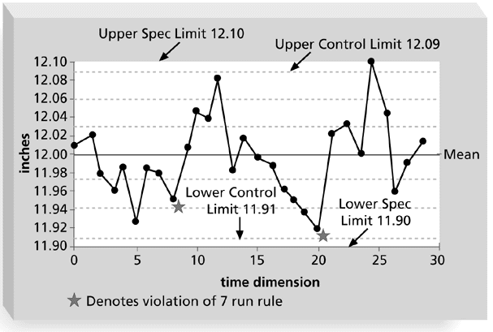
Sample Quality Control Chart
The rule violations indicate that a calibration device may need adjustment

Slide 46
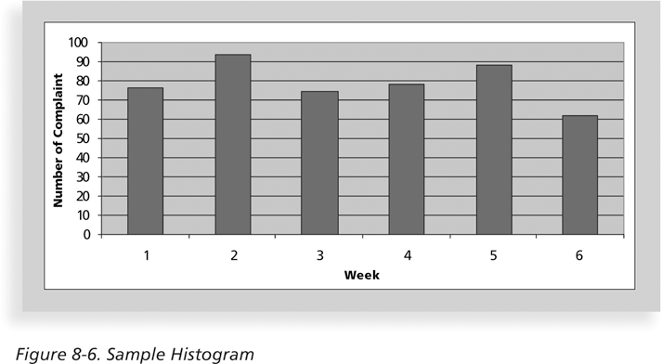
Histograms
A histogram is a bar graph of a distribution of variables
Each bar represents an attribute or characteristic of a problem or situation, and the height of the bar represents its frequency

Slide 47
Pareto Charts
A Pareto chart is a histogram that can help you identify and prioritize problem areas
The variables are ordered by frequency of occurrence to help identify the key contributors that account for most quality problems (hopefully following the 80-20 rule)
Pareto analysis is also called the 80-20 rule, meaning that 80 percent of problems are often due to 20 percent of the causes
In the following chart, Log-in Problems account for about 55% of the complaints and together with System lock-ups accounts for about 80%
Fixing these two problems can greatly reduce the volume of compalints
Small problems should be investigated before addressing them in case the user is in error

Slide 48
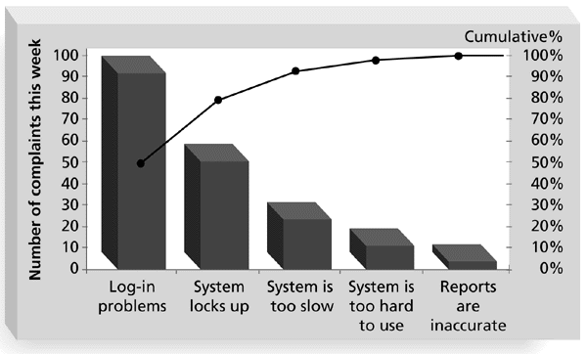
Sample Pareto Diagram

Slide 49
STATISTICAL SAMPLING AND TESTING

Slide 50
Acceptance Sampling
Accept/reject entire lot based on sample results
Created by Dodge and Romig during WWII
Not consistent with TQM of zero defects
Does not estimate the quality of the lot

Slide 51
What is Acceptance Sampling?
Lot acceptance sampling
A SQC technique where a random sample is taken from a lot and upon the results of appraising the sample, the lot will either be rejected or accepted.
A procedure for sentencing incoming batches or lots of items without doing 100% inspection

Slide 52
What is Acceptance Sampling?
Purposes
Determine the quality level of an incoming shipment at the end of the production
Judge whether the quality level is within the level that has been predetermined
But acceptance sampling gives you no idea about the process that is producing those items.

Slide 53
Another area of quality control and improvement
Closely connected with inspection and testing of products
Inspection can occur at many points in a process
Acceptance Sampling : the inspecting and classification of a sample selected at random from a large batch or a lot and ultimate decision about the disposition of the lot.

Slide 54
Sampling Plans
Plans that specify lot size, sample size, number of samples and acceptance/ rejection criteria
Single sampling
Double sampling
Multiple sampling and sequential sampling

Slide 55
Why use acceptance sampling
Can do either 100% inspection or inspect a sample of dew items taken from a lot
Complete inspection
Inspecting each items produced to see if each item meets the level desired
Used when defective items would be very detrimental in some way
Sampling involves risk –
- good product may be rejected
- bad product may be accepted

Slide 56
Why not 100% inspection
Problems with 100% inspection
Generally very expensive
Can not use when product must be destroyed to test it
Handling by inspectors can induce defects
Inspection may be very tedious so defective items may slip through even 100% inspection

Slide 57
A Lot-by Lot Sampling Plan
Count Numbers Accept or
conforming Reject Lot
Specify the plan (n,c) for given N
For a lot size N, determine
the sample size n and
The acceptance number c
Reject lot if number of defect> c
Specify course of action if lot is rejected
N
(Lot)
n
(sample)

Slide 58
Sampling Terms
Acceptable Quality Level (AQL) – the percentage of the defects at which consumers are willing to accept lot as “good”
Lot Tolerance Percentage Defectives (LTPD or RQL) – the upper limit on the percentage of the defects that a consumer is willing to accept
Consumer’s Risk: the probability that a lot contain defective exceeding the LTPD will be accepted
Producer’s Risk: the probability that a lot containing the acceptable quality level will be rejected

Slide 59
Three approaches for sentencing a lot
Single Sampling
For low cost or low impact material on the subsequent process
From trusted supplier
Rectified Sampling
Inspect every item in the lot, then remove the defective units by reworking or returning to the supplier
For critical process defective items may result high failure cost
From new supplier
Double or multiple sampling
When 100% inspection is too costly
Trusted supplier with potential risk

Slide 60
Single Sampling Plan
Advantages
Less expensive because of less inspection
- works with single sample
- Protects both consumers and producers
Rejection on entire lot motivates quality improvements for suppliers
Disadvantages
Risk of accepting a lot of poor quality
Risk of rejecting a lot of acceptable quality
Requires planning and documentation
Requires extensive study on consumer requirements

Slide 61
Lot Formation
Lots should be such that…
produced on the same machines, by same operators, from common raw materials at approximately the same time period
Larger lots are better than smaller lots
these are more representative of the overall quality
Lots should be comfortable to the material handling systems and personnel.
Random Selection

Slide 62
Testing
Many IT professionals think of testing as a stage that comes near the end of IT product development
Testing should be done during almost every phase of the IT product development life cycle

Slide 63
TOTAL QUALITY MANAGEMNET (TQM)

Slide 64
Definition of TQM
“A management philosophy embracing all activities through which the needs and expectations of the CUSTOMER and COMMUNITY, and the objectives of the organization are satisfied in the most efficient and cost effective manner by maximising the potential of ALL employees in a continuing drive for improvement.”

Slide 65
Requires cultural change – prevention not detection, pro-active versus fire-fighting, life-cycle costs not price, etc.
Many companies will not start this transformation unless faced with disaster/problems or forced by customers

Slide 66
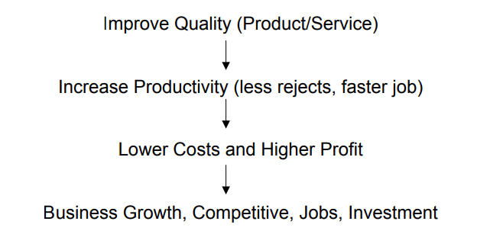
Effect of TQM (Quality Improvement)

Slide 67
TQM Six Basic Concepts
Leadership
Customer Satisfaction
Employee Involvement
Continuous Process Improvement
Supplier Partnership
Performance Measures

Slide 68
Criteria 1 : Leadership
Top management must realize importance of quality
Quality is responsibility of everybody, but ultimate responsibility is CEO
Involvement and commitment to Quality Improvement
Quality excellence becomes part of business strategy
Lead in the implementation process

Slide 69
Characteristics of Successful Leaders
Give attention to external and internal customers
Empower, not control subordinates. Provide resources, training, and work environment to help them do their jobs
Emphasize improvement rather than maintenance
Emphasize prevention
Encourage collaboration rather than competition
Train and coach, not direct and supervise
Learn from problems – opportunity for improvement
Continually try to improve communications
Continually demonstrate commitment to quality
Choose suppliers on the basis of quality, not price
Establish organisational systems that supports quality efforts

Slide 70
Implementation Process
• Must begin from top management
• Cannot be delegated (lack of involvement cited as principle reason for failure)
• Top/senior management must be educated on TQM philosophy and concepts
• Visits to TQM companies, read books, attend seminars
• Need a roadmap/framework for implementation – consider timing (any crisis)
• Formation of Quality Council – policies, strategies, programmes

Slide 71
Criteria 2:Customer Satisfaction
• Customer is always right – in Japan customer is “King”
• Customer expectations constantly changing – 10 years ago acceptable, now not any more!
• Delighting customers (Kano Model)
• Satisfaction is a function of total experience with organization
• Need to continually examine the quality systems and practices to be responsive to ever – changing needs, requirements and expectations – Retain and Win new customers

Slide 72
Issues for customer satisfaction
Checklist for both internal and external customers
Who are my customers?
What do they need?
What are their measures and expectations?
Does my product/service exceed their expectations?
How do I satisfy their needs?
What corrective action is necessary?

Slide 73
Customer Feedback
• Discover customer dissatisfaction
• Discover priorities of quality, price, delivery
• Compare performance with competitors
• Identify customer’s needs
• Determine opportunities for improvement

Slide 74
Customer Feedback Tools/Method
• Warranty cards/Questionnaire
• Telephone/Mail Surveys
• Focus Groups
• Customer Complaints
• Customer Satisfaction Index

Slide 75
Criteria 3: Employee Involvement
• People – most important resource/asset
• Quality comes from people
• Deming – 15% operator errors, 85% management system
• Education and training – life long, continuous both knowledge and skills
• Motivational programmes, incentive schemes
• Conducive work culture, right attitude, commitment

Slide 76
Criteria 4: Continuous Process Improvement
• View all work as process
• Process – purchasing, design, invoicing, etc.
• Inputs – PROCESS – outputs
• Process improvement – increased customer satisfaction
• Improvement – 5 ways; Reduce resources, Reduce errors, Meet expectations of downstream customers, Make process safer, make process more satisfying to the person doing

Slide 77
Criteria 5: Supplier Partnership
• 40% prod. Cost comes from purchased materials, therefore supplier Quality Management important
• Substantial portion quality problems from suppliers
• Need partnership to achieve quality improvement – long-term purchase contract
• Supplier Management activities
• Define product/program requirements;

Slide 78
Evaluate potential and select the best suppliers
Conduct joint quality planning and execution
Require statistical evidence of quality
Certify suppliers, e.g. ISO 900, Ford Q1
Develop and apply Supplier Quality Ratings
Defects/Percent non-conforming 
Price and Quality costs 
Delivery and Service

Slide 79
Criteria 6: Performance Measures
• Managing by fact rather than gut feelings
• Effective management requires measuring
• Use a baseline, to identify potential projects, to asses results from improvement
• E.g. Production measures – defects per million, inventory turns, on-time delivery
• Service – billing errors, sales, activity times
• Customer Satisfaction
• Methods for measuring
• Cost of poor quality

Slide 80
Performance Measures (continue)
Benchmarking – grade to competitors, or best practice
Statistical measures – control charts
Certifications

